Slide 1

IBM SkillsBuild for Adult Learners - Data Analytics
Data Analytics Internship Program 2024 Final Project Presentation
Project Name: DeepLeaf: Automated Plant Disease Detection and Severity Assessment
Unique ID : 1647
Team Name :TETRIS
College Name : Guru Gobind Singh Indraprastha University

Slide 2
Team Members
Ankit Sharma
Ayush Kumar
Fahed Ahmad
Kushagra Maheshwari
Sandeep Mishra
Shreya Shree
Tarun Bhardwaj
Yash Raj Vaid

Slide 3
Introduction
Overview:
The DeepLeaf project aims to transform plant disease management by utilizing machine learning (ML) and deep learning (DL) technologies. This project addresses the urgent need for accurate, automated solutions in agriculture, aiming to improve global food security and align with SDG Goal 3: Good Health & Well-being.
Objectives:
Data Acquisition:
Compile a diverse dataset of plant leaf images.
Data Preprocessing:
Enhance data quality through normalization and augmentation.
Machine Learning Models:
Deploy Convolutional Neural Networks (CNNs) for precise disease detection.
Apply deep learning to assess disease severity.
Model Evaluation:
Validate using metrics like accuracy, precision, and recall.

Slide 4
Problem Identification
Problem Statement
Agriculture, a cornerstone of global economic stability, faces significant challenges due to plant diseases, leading to substantial crop losses. Traditional methods for detecting and assessing these diseases are labor-intensive, subjective, and prone to errors. There is an urgent need for automated, accurate, and scalable solutions that can swiftly predict plant disease severity, enhancing agricultural productivity.
Significance of the Problem
Global Food Security: Enhancing plant health is crucial for a stable food supply.
Economic Impact: Crop losses due to disease impact farmers' livelihoods and national economies.
Efficiency: Automation improves detection speed, accuracy, and reduces manual labor.
Technological Innovation: Promotes advanced ML and DL adoption in agriculture
Relevant SDGs
SDG 2: Zero Hunger: Enhancing crop health directly contributes to improved food security and nutrition.
SDG 3: Good Health and Well-being: Ensuring plant health aligns with promoting overall ecosystem well-being.
SDG 12: Responsible Consumption and Production: Effective disease management leads to sustainable agricultural practices.

Slide 5
Data Collection
Sources of Data
Origin: Kaggle and PlantVillage
Link: https://www.kaggle.com/datasets/abdallahalidev/plantvillage-dataset
Format: .jpg and .png images
Data Description
Classes: Includes plant diseases like "Apple Scab," "Tomato Mosaic Virus," etc.
Severity Levels: Each class has multiple severity levels, indicated by numbers (e.g., Apple___1).
Image Size: Resized to 128x128 pixels in RGB format.
Data Collection Methods
Structure: Hierarchical folders for each disease and severity level.
Labeling: Extracted using regex to ensure accurate class categorization.
Processing:
Loading: Images are read and formatted using Python libraries.
Normalization: Rescaled to [0, 1] range.
Augmentation: Techniques like rotation, scaling, and flipping enhance dataset diversity.

Slide 6
Data Preprocessing
Data Cleaning Methods
Handling Missing Values
Detection: Identified missing or corrupt entries during image processing.
Imputation: Default severity value of 0 is assigned when severity information is missing from labels.
Exclusion: In cases where images cannot be processed, these are excluded from the dataset.
Data Transformation Techniques
Normalization: Images are rescaled to [0, 1] to standardize pixel values for model input.
Resizing: All images are resized to 128x128 pixels to ensure uniformity.
Augmentation: Applied techniques include:
Rotation: Up to 40 degrees
Width/Height Shift: 20%
Shear and Zoom: 20%
Horizontal Flip: To enhance dataset diversity and model robustness.

Slide 7
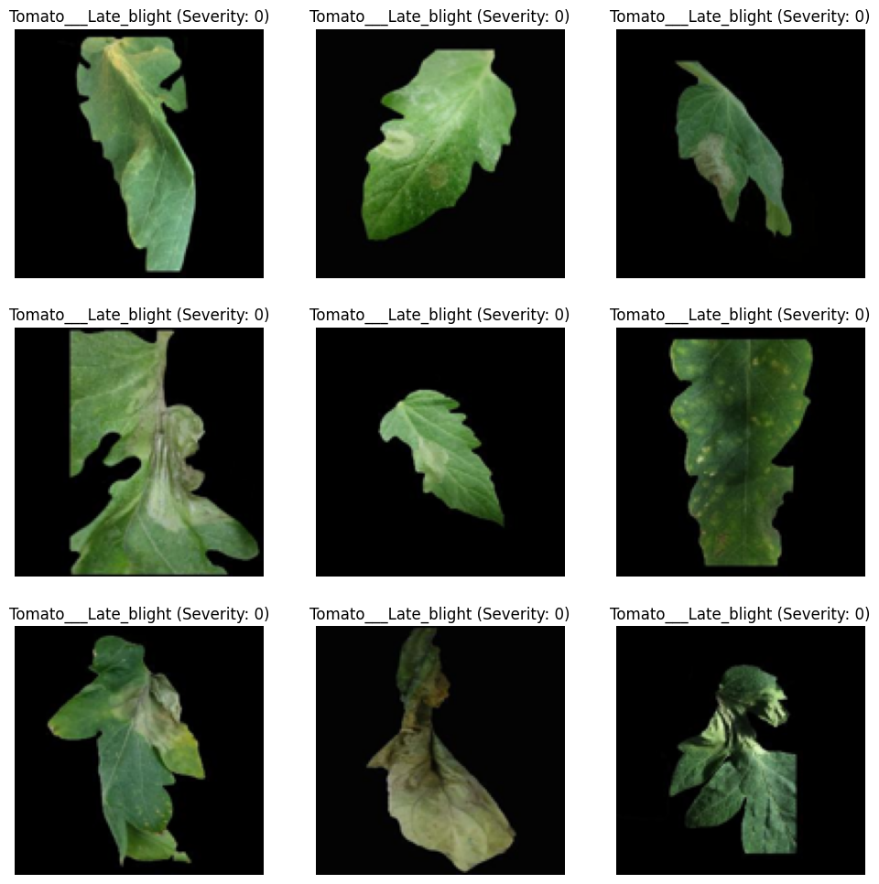
After Data Preprocessing

Slide 8
Data Analysis
Analytical Tools and Methods Used
Tools
Python Libraries:
NumPy, Pandas: Data manipulation and analysis.
Matplotlib, Seaborn: Visualization of results.
Deep Learning Frameworks:
TensorFlow/Keras: Model development and training.
Scikit-learn: Evaluation metrics and preprocessing.
Methods
Model Development:
CNN Architecture: Convolutional layers, pooling, and dense layers for disease classification.
Data Augmentation: Rotation, scaling, and flipping to enhance model robustness.
Evaluation Metrics:
Precision, Recall, F1 Score: Measure model performance on test data.

Slide 9
Hypothesis Development
Formulated Hypothesis
Hypothesis: Machine learning and deep learning models can significantly improve the accuracy and efficiency of plant disease detection and severity assessment compared to traditional methods.
Rationale Behind the Hypothesis
Current Methods: Traditional plant disease detection is labor-intensive, subjective, and error-prone.
Advancements: ML and DL techniques offer automated, scalable, and precise solutions through advanced image recognition.
Expected Benefits: Improved accuracy in disease identification and severity assessment leading to better crop management and reduced losses.
Method for Testing the Hypothesis
Data Preparation:
Preprocessing: Normalize and resize images; handle missing data.
Augmentation: Apply techniques to enhance dataset diversity.
Model Development:
CNN Training: Use TensorFlow/Keras to build and train convolutional neural networks.
Evaluation:
Metrics: Assess precision, recall, and F1 score.
Validation: Compare model predictions with ground truth annotations and evaluate performance on test data.

Slide 10
Solution Design
Proposed Solution
Automated System: Develop a machine learning-based system for plant disease detection and severity assessment using high-resolution images.
Deep Learning Models: Utilize Convolutional Neural Networks (CNNs) to enhance accuracy in identifying and classifying diseases.
Severity Assessment: Implement deep learning techniques to quantify disease severity for timely intervention.
Implementation Plan
Data Collection:
Gather and preprocess plant leaf images from sources like Kaggle and PlantVillage.
Model Development:
Build and train CNN models using TensorFlow/Keras.
Apply data augmentation techniques to improve model robustness.
Evaluation and Testing:
Assess model performance using precision, recall, and F1 score.
Validate with real-world datasets to ensure practical applicability.
Alignment with SDGs
SDG 3 (Good Health and Well-being):
Objective: Improve agricultural productivity and food security.
Impact: Early disease detection leads to better crop management, reducing losses and supporting sustainable agriculture.

Slide 11
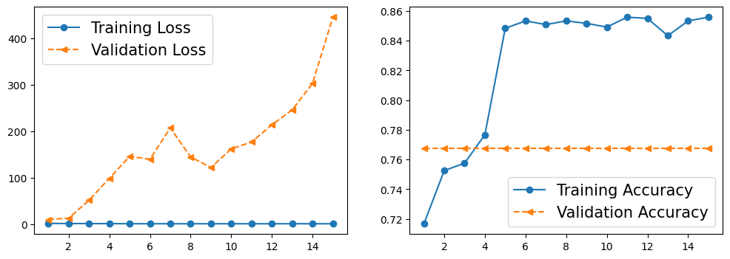
Visualization
Data Visualization Techniques Used
Charts:
Line Charts: Track training and validation loss/accuracy over epochs.

Slide 12
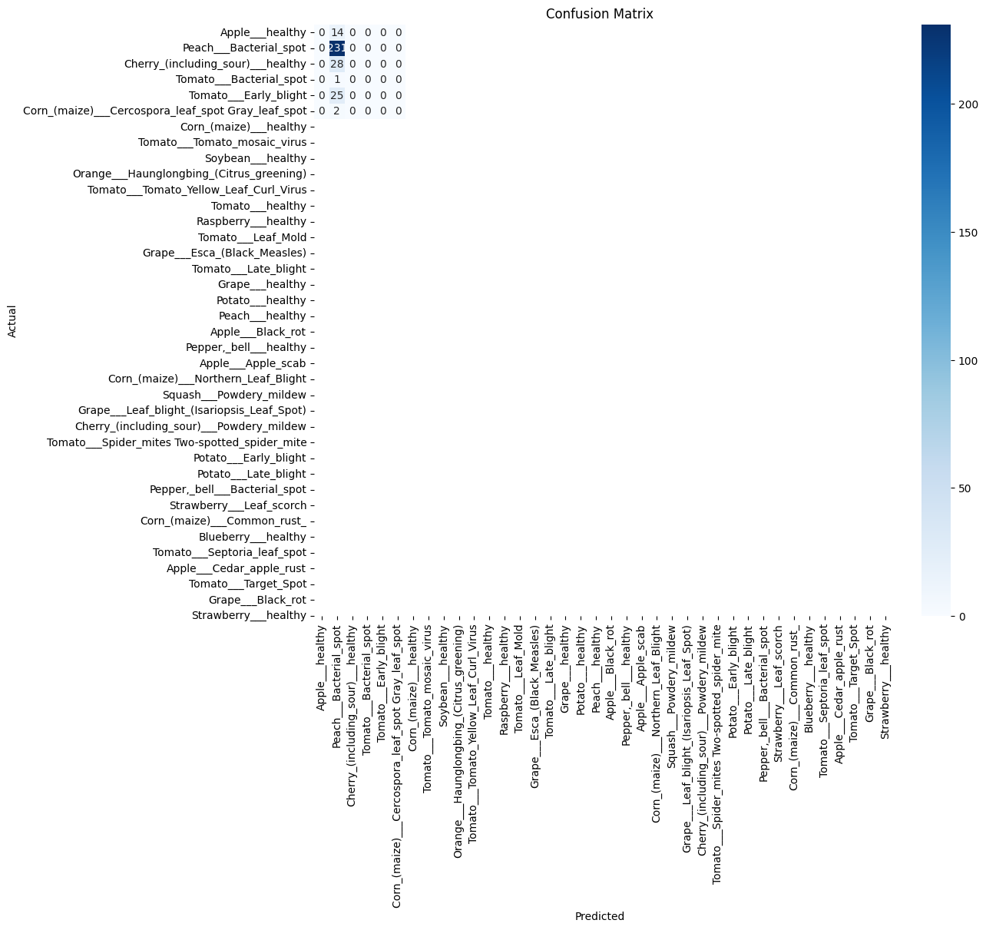
Graphs:
Confusion Matrix: Visualizes model performance and misclassifications.

Slide 13
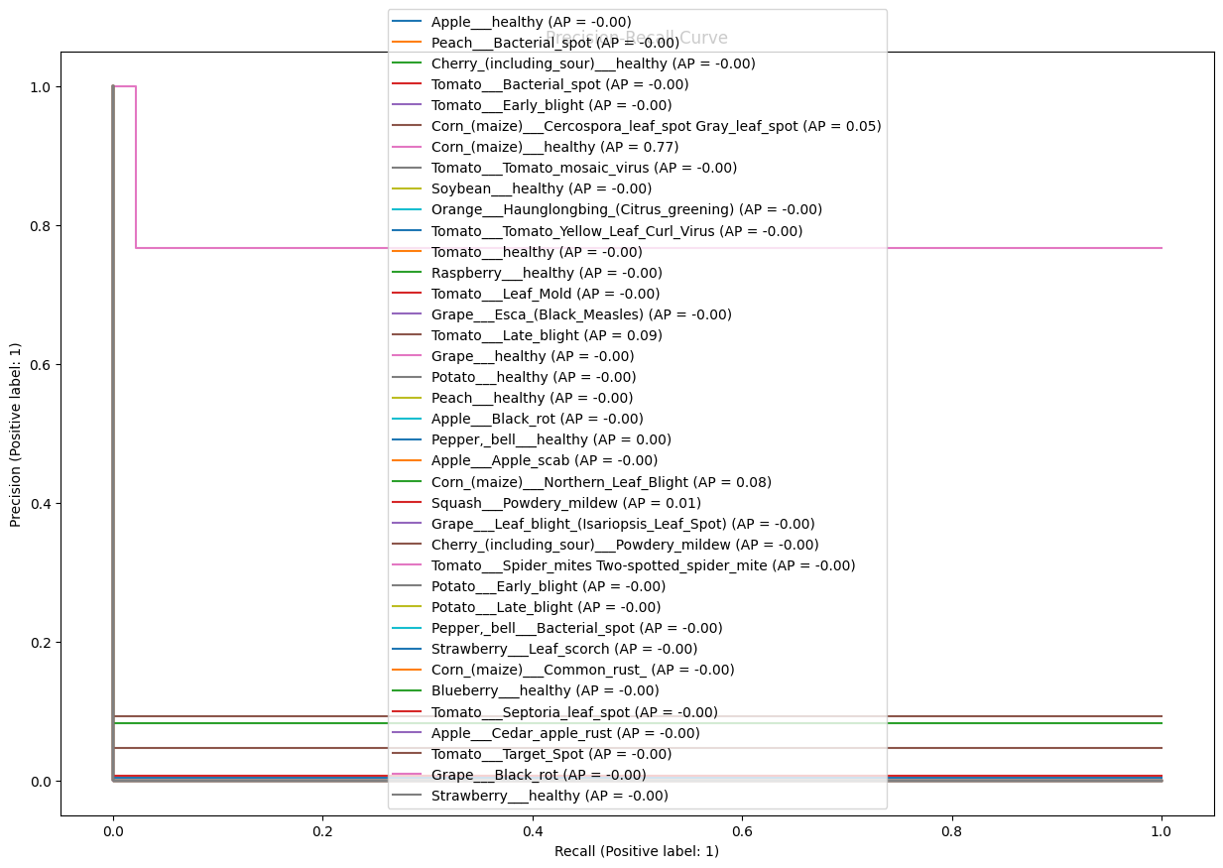
ROC Curve: Illustrates model's ability to distinguish between classes.
Key Visual Insights
Training Progress: Line charts reveal how the model improves over time with each epoch.
Performance Metrics: Bar charts highlight the precision, recall, and F1 score of the model, showing its effectiveness.
Error Analysis: Confusion matrix identifies classes where the model struggles and misclassifications, guiding further improvements.

Slide 14
Conclusion
Summary of Findings
Model Performance:
Precision: 0.6879
Recall: 0.7774
F1 Score: 0.6882
Effectiveness: Deep learning models significantly enhance accuracy in detecting and assessing plant diseases.
Visualization Insights: Confusion matrix and performance metrics reveal strengths and areas for improvement in disease classification.
Impact of Proposed Solution
Enhanced Accuracy: Automated disease detection improves identification and severity assessment, reducing manual errors.
Increased Efficiency: Streamlined process for early intervention and management of plant diseases, leading to better crop health.
Support for Agriculture: Contributes to sustainable agricultural practices by reducing crop losses and improving productivity.
Future Work
Model Refinement: Improve precision and recall by incorporating more diverse datasets and advanced models.
Real-World Deployment: Integrate the solution into agricultural tools and platforms for practical use by farmers.
Extended Research: Explore additional applications, such as integrating with other agricultural monitoring systems or extending to new plant species

Slide 15
References
Data Sources
Plant Village Dataset:
Description: Publicly available dataset with images of healthy and diseased plant leaves.
Kaggle:
Description: Repository of various datasets for plant disease detection and severity assessment.
Tools and Software Used
Programming Languages:
Python: For data manipulation, model development, and evaluation.
Libraries and Frameworks:
NumPy, Pandas: Data handling and analysis.
Matplotlib, Seaborn: Visualization of results.
TensorFlow/Keras: Model development and training.
Scikit-learn: Model evaluation and preprocessing.
Development Environments:
Jupyter/Google Colab: For documenting and running code.
Additional References
Research Papers: Relevant literature on plant disease detection using machine learning and deep learning.
Documentation: Official documentation for TensorFlow, Keras, and Scikit-learn for model development and evaluation.
Tutorials: Online resources and tutorials for advanced machine learning techniques and data preprocessing.

